Slide 1

Machine Learning for Cities
CUSP-GX 5006.001, Spring 2018
Lecture 13: Anomalous Pattern Detection

Slide 2
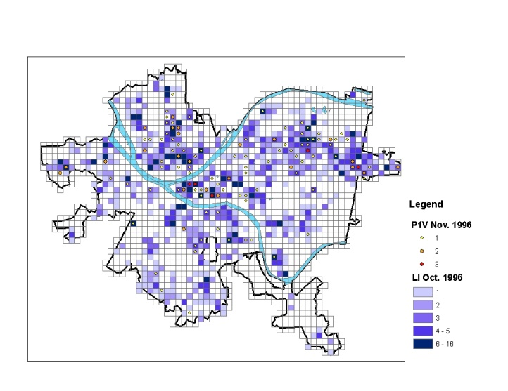
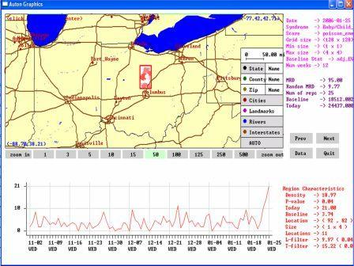
Anomalous pattern detection
Main goal of pattern detection: to identify and characterize relevant subsets of a massive dataset, i.e. groups of records that differ from the rest of the data in an interesting way.
Question 1: Are any relevant patterns present in the data, or is the entire dataset “normal”?
Question 2: If there are any patterns, identify the pattern type and the affected subset of data records for each.
Example: outbreak detection
Are there any emerging outbreaks of disease? If so, what type of outbreak, and what areas are affected?
Example: crime prevention
Can we detect, or ideally predict, emerging hot-spots of violent crime, and prevent crime by targeted police patrols?

Slide 3
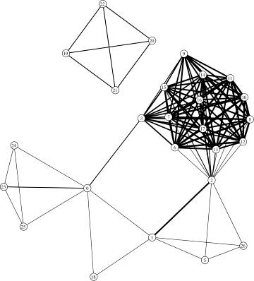
Anomalous pattern detection
Main goal of pattern detection: to identify and characterize relevant subsets of a massive dataset, i.e. groups of records that differ from the rest of the data in an interesting way.
What makes a group of records “relevant”?
Group detection: given a social network, find highly connected sets of individuals.
1. Matching some known pattern or structure.
Many efficient algorithms have been developed to find dense subgraphs or other structures in network data.

Slide 4
Anomalous pattern detection
Main goal of pattern detection: to identify and characterize relevant subsets of a massive dataset, i.e. groups of records that differ from the rest of the data in an interesting way.
What makes a group of records “relevant”?
Fraud detection: look for individuals with a history of suspicious transactions.
1. Matching some known pattern or structure.
Network intrusion detection: look for suspicious combinations of activities (e.g. port scanning).
2. Multiple related records that are individually anomalous.
In these domains, multiple “slightly anomalous” behaviors may together provide evidence of a major deviation from normal.

Slide 5
Anomalous pattern detection
Main goal of pattern detection: to identify and characterize relevant subsets of a massive dataset, i.e. groups of records that differ from the rest of the data in an interesting way.
What makes a group of records “relevant”?
Cluster detection: find spatial areas or periods of time with more records than expected.
1. Matching some known pattern or structure.
Event detection: is the recent data differently distributed than the past?
2. Multiple related records that are individually anomalous.
3. Higher (or lower) than expected number of records with some combination of attributes.
Key concept: A group of records may be highly anomalous or interesting even if none of the individual records is itself anomalous.
4. Change in data distribution as compared to the rest of the dataset.

Slide 6
Pattern detection = classification?
“Does the dataset contain a pattern?”
This question could be treated as a problem of classifying datasets.
“Which records are affected?” This question could be treated as classification or anomaly detection.
Dataset D → {normal, contains a pattern}
Or D → {normal, pattern 1, pattern 2, …}
Record x_{i} → {normal, is part of a pattern}
Or x_{i} → {normal, pattern 1, pattern 2, …}
For the first approach, what features of the dataset should we use?
Most relevant patterns only affect a small proportion of the dataset, and would not be visible looking only at summary statistics.
On the other hand, data sparsity prevents using each record-attribute combination as a different attribute of the dataset.
For the second approach, how can we combine data from multiple records?
This is essential since none of the records may be individually sufficient to detect the anomalous pattern.

Slide 7
Question: Why search over subsets? Answer: Simpler approaches can fail.
Top-down detection approaches
Bottom-up detection approaches
Are there any globally interesting patterns? If so, recursively search the most interesting sub-partition.
Two examples: bump hunting; “cluster then detect”.
Find individually (or locally) anomalous data points, and optionally, aggregate into clusters.
Two examples: anomaly/outlier detection; density-based clustering.
Top-down fails for small-scale patterns that are not evident from the global aggregates.
Bottom-up fails for subtle patterns that are only evident when a group of data records are considered collectively.

Slide 8
Subset scanning
We can scan over subsets of the dataset in order to find those groups of records that correspond to a pattern.
Step 1: Compute score F(S, P) for each subset S = {x_{i}} and for each pattern type P, where higher score means more likely to be a pattern.
Step 2: Consider the highest scoring potential patterns (S, P) and decide whether each actually represents a pattern.
There are many options for computing the score of a subset S.

Slide 9
What’s Strange About Recent Events?
We can scan over subsets of the dataset in order to find those groups of records that correspond to a pattern.
Step 1: Compute score F(S, P) for each subset S = {x_{i}} and for each pattern type P, where higher score means more likely to be a pattern.
Step 2: Consider the highest scoring potential patterns (S, P) and decide whether each actually represents a pattern.
There are many options for computing the score of a subset S.
In the WSARE method (“What’s Strange About Recent Events”), we consider the subsets of the data defined by a one- or two-component rule R, and find rules where the current data is significantly different than the past.
For each rule, we create a 2x2 contingency table comparing current and past data:
Current
Past
Compute p-value using a statistical test (Χ² or Fisher’s Exact). Lower p-value = higher score.
# records satisfying R
# records satisfying ~R
48
86
45
220

Slide 10
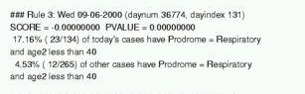
What’s Strange About Recent Events?
We can scan over subsets of the dataset in order to find those groups of records that correspond to a pattern.
Step 1: Compute score F(S, P) for each subset S = {x_{i}} and for each pattern type P, where higher score means more likely to be a pattern.
Step 2: Consider the highest scoring potential patterns (S, P) and decide whether each actually represents a pattern.
There are many options for computing the score of a subset S.
In the WSARE method (“What’s Strange About Recent Events”), we consider the subsets of the data defined by a one- or two-component rule R, and find rules where the current data is significantly different than the past.
For example, using WSARE for hospital Emergency Department surveillance resulted in finding the following significant rule, corresponding to an outbreak of respiratory illness on 9/6/2000.

Slide 11
Anomaly pattern detection
We can scan over subsets of the dataset in order to find those groups of records that correspond to a pattern.
Step 1: Compute score F(S, P) for each subset S = {x_{i}} and for each pattern type P, where higher score means more likely to be a pattern.
Step 2: Consider the highest scoring potential patterns (S, P) and decide whether each actually represents a pattern.
There are many options for computing the score of a subset S.
If we do not have access to past data, but we have access to the output of an anomaly detector, we can modify WSARE to detect rules R that correspond to a higher than expected number of anomalous records.
Now we create tables comparing the numbers of anomalous and normal records:
Anomalous
Normal
Compute p-value using a statistical test (Χ² or Fisher’s Exact). Lower p-value = higher score.
# records satisfying R
# records satisfying ~R
17
93
5
400

Slide 12
Model-based pattern detection
We can scan over subsets of the dataset in order to find those groups of records that correspond to a pattern.
Step 1: Compute score F(S, P) for each subset S = {x_{i}} and for each pattern type P, where higher score means more likely to be a pattern.
Step 2: Consider the highest scoring potential patterns (S, P) and decide whether each actually represents a pattern.
There are many options for computing the score of a subset S.
In the model-based anomalous pattern detection approach, we model the effects of each pattern type P on the affected subset of the data S.
We then compute the likelihood ratio statistic Pr(Data | H₁(S, P)) / Pr(Data | H₀) for each (S, P).
In event detection, we model the null hypothesis H₀ by estimating expected counts for each data stream assuming no events.
Each pattern P is assumed to increase the counts for some data streams in the affected set of spatial locations S.

Slide 13
Anomalous group detection
We can scan over subsets of the dataset in order to find those groups of records that correspond to a pattern.
Step 1: Compute score F(S, P) for each subset S = {x_{i}} and for each pattern type P, where higher score means more likely to be a pattern.
Step 2: Consider the highest scoring potential patterns (S, P) and decide whether each actually represents a pattern.
There are many options for computing the score of a subset S.
In the model-based anomalous pattern detection approach, we model the effects of each pattern type P on the affected subset of the data S.
We then compute the likelihood ratio statistic Pr(Data | H₁(S, P)) / Pr(Data | H₀) for each (S, P).
In our AGD (“Anomalous Group Detection”) approach, we model the null hypothesis by learning a Bayes Net from training data.
Under the alternative hypothesis H₁(S), we assume that records in S are drawn from a different Bayes Net.

Slide 14
Which patterns to report?
We can scan over subsets of the dataset in order to find those groups of records that correspond to a pattern.
Step 1: Compute score F(S, P) for each subset S = {x_{i}} and for each pattern type P, where higher score means more likely to be a pattern.
Step 2: Consider the highest scoring potential patterns (S, P) and decide whether each actually represents a pattern.
Option 1: Report the k highest scoring subsets, ordered by score.
The disadvantage of this approach is that the user is not informed whether any of the discovered patterns are likely to be relevant.
However, this may be acceptable in monitoring systems or scientific discovery applications where the user is willing to evaluate a fixed number of potential patterns.

Slide 15
Which patterns to report?
We can scan over subsets of the dataset in order to find those groups of records that correspond to a pattern.
Step 1: Compute score F(S, P) for each subset S = {x_{i}} and for each pattern type P, where higher score means more likely to be a pattern.
Step 2: Consider the highest scoring potential patterns (S, P) and decide whether each actually represents a pattern.
Option 2: Perform hypothesis tests, and report all significant patterns (S, P).
In the hypothesis testing framework, we must adjust for the fact that we’re performing so many tests. Otherwise we will report too many false positives!
In model-based approaches, one way to do this is randomization: we generate a large number of simulated datasets assuming the null model, and compare the scores of the potential patterns in the real dataset to the highest scoring patterns in the simulated data.
An alternative is to adjust the p-value threshold for each test based on the number of tests performed (e.g. Bonferroni threshold = .05 / # tests)

Slide 16
Which patterns to report?
We can scan over subsets of the dataset in order to find those groups of records that correspond to a pattern.
Step 1: Compute score F(S, P) for each subset S = {x_{i}} and for each pattern type P, where higher score means more likely to be a pattern.
Step 2: Consider the highest scoring potential patterns (S, P) and decide whether each actually represents a pattern.
Option 3: Compute the posterior probability of each hypothesis H₁(S, P).
In a Bayesian framework, we must spread the prior probability of a pattern over all possible hypotheses H₁(S, P).
We then compute the likelihood of the data given each hypothesis H₁(S, P), as well as the null hypothesis of no patterns, H₀.
We can then compute the posterior probability of each hypothesis by Bayes’ Theorem:
Best for known pattern types!
Pr(H | D) = Pr(D | H) Pr(H) / Pr(D)
Option 2 better for anomalies!

Slide 17
Which subsets to scan?
Since there are exponentially many subsets of the data, it is often computationally infeasible to search all of them.
The most common approach is to use domain knowledge to restrict our search space: for example, in spatial cluster detection, we assume that a pattern will affect a spatially localized group of records, and often further restrict the cluster size and shape.
e.g. “search over circular regions centered at a data point” → only N² regions instead of 2^{N}.
Another common approach is to perform a greedy search. For example, we grow subsets starting from each record, repeatedly adding the additional record that gives the highest scoring subset.
Tradeoff: much more efficient than naïve search, but not guaranteed to find highest scoring region.
In some cases, we can find the highest-scoring subsets without actually computing the scores of all possible subsets!

Slide 18
Example: fast spatial scan
In spatial cluster detection, we search over sets of adjacent locations and find spatial regions with significantly higher than expected counts.
We restrict our search to rectangular regions for computational efficiency. This gives us high detection power for both compact and elongated clusters.
For massive datasets (e.g. disease surveillance for nationwide health data), we have to search over billions of possible regions, which could take weeks.
We can find the highest scoring clusters without an exhaustive search using branch and bound: we keep track of the highest region score that we have found so far, and prune sets of regions with provably lower scores.
A new multi-resolution data structure, the overlap-kd tree, enables us to make this search efficient.
We can now monitor nationwide health data in 20 minutes (vs. 1 week).

Slide 19
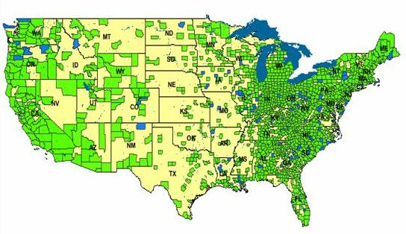
Linear-time subset scanning
Given a score function F(S) which satisfies the linear-time subset scanning property, we can optimize F(S) over the exponentially many subsets of data records, while evaluating only O(N) regions instead of O(2^{N}).
Just sort the locations from highest to lowest priority according to some function, then search over groups consisting of the top-k highest priority locations (k = 1..N). The highest scoring subset will be one of these!
Many useful score functions satisfy the LTSS property. In the spatial cluster detection setting, we can efficiently optimize a spatial scan statistic over subsets of locations to find the most interesting spatial region.
This works both for univariate data, monitoring a single data stream across time and space, and multivariate data, monitoring multiple data streams.
We can also incorporate relevant constraints such as spatial proximity, temporal consistency, or graph connectivity into the detection process.

Slide 20
Linear-time subset scanning
Given a score function F(S) which satisfies the linear-time subset scanning property, we can optimize F(S) over the exponentially many subsets of data records, while evaluating only O(N) regions instead of O(2^{N}).
Just sort the locations from highest to lowest priority according to some function, then search over groups consisting of the top-k highest priority locations (k = 1..N). The highest scoring subset will be one of these!
Many useful score functions satisfy the LTSS property. In the spatial cluster detection setting, we can efficiently optimize a spatial scan statistic over subsets of locations to find the most interesting spatial region.
This works both for univariate data, monitoring a single data stream across time and space, and multivariate data, monitoring multiple data streams.
LTSS allows us to solve problems in milliseconds that would previously have required hundreds of millions of years!

Slide 21
DBSCAN in scikit-learn
DBSCAN is a bottom-up density-based clustering method which can be used either for clustering or for anomalous (dense) cluster detection.
Main steps: DBSCAN identifies all individual points with “dense” local neighborhoods (at least MinPts points within radius eps).
Then, it merges nearby dense points (and all other points within radius eps of them) into clusters. Remaining points in the dataset are not placed into any cluster.
Results of DBSCAN are critically dependent on choice of parameters MinPts and eps:
Smaller MinPts, larger eps: almost all points assigned to clusters. Use like a standard clustering method, but robust to outliers, don’t need to specify # clusters.
Larger MinPts, smaller eps: most points are unassigned. Clusters represent small spatial areas that are unusually dense compared to the rest of the data.
Our approach to using DBSCAN for anomalous cluster detection:
Scan through a wide range of parameter values. Choose values where # of points assigned to clusters is >0 but <10% of the data.

Slide 22
References
A coherent text on anomalous pattern detection has yet to be written, but many methods have been proposed and are becoming common.
WSARE: W.-K. Wong et al. Rule-based anomaly pattern detection for detecting disease outbreaks. Proc. AAAI Conf., 2002.
APD: K. Das, J. Schneider, and D.B. Neill. Anomaly pattern detection in categorical datasets. Proc. KDD Conf., 2008.
DBSCAN: M. Ester et al. A density-based algorithm for discovering clusters in large spatial databases with noise. Proc. KDD Conf., 1996. http://scikit-learn.org/stable/modules/generated/sklearn.cluster.DBSCAN.html
Spatial scan: M. Kulldorff. A spatial scan statistic. Comm. Stat. Theor. Meth., 1997.
Fast subset scan: D.B. Neill. Fast subset scan for spatial pattern detection, J. Royal Stat. Soc. B, 2012.
More detailed tutorial slides on event detection:
D.B. Neill and W.-K. Wong, “A Tutorial on Event Detection,” presented at KDD 2009 conference.

